Slide 1
Data Structures
18. Binary Tree Implementation

Slide 2
Tree ADT
Data Type: Any type of objects can be stored in a tree
Accessor methods
root() – return the root of the tree
parent(p) – return the parent of a node
children(p) – return the children of a node
Query methods
size() – return the number of nodes in the tree
isEmpty() – return true if the tree is empty
elements() – return all elements
isRoot(p) – return true if node p is the root
Other methods
Tree traversal, Node addition/deletion, create/destroy

Slide 3
Binary Tree Storage
Contiguous storage
Linked list based storage

Slide 4
Contiguous Storage

Slide 5
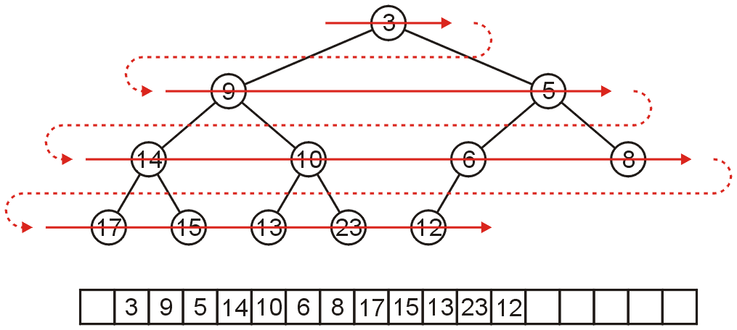
Array Storage (1)
We can store a binary tree as an array
Traverse tree in breadth-first order, placing the entries into array
Storage of elements (i.e., objects/data) starts from root node
Nodes at each level of the tree are stored left to right

Slide 6
Array Storage Example (1)
A
[1]
[2]
[3]
[4]
[5]
[6]
[7]
[8]
[9]
A
B
C
D
E
F
G
H
I
B
C
D
E
F
G
H
I

Slide 7
Array Storage Example (2)
Unused nodes in tree represented by a predefined bit pattern
A
[1]
[2]
[3]
[4]
[5]
[6]
[7]
[8]
[9]
…
[16]
A
B
-
C
-
-
-
D
-
…
E
B
C
D
E

Slide 8
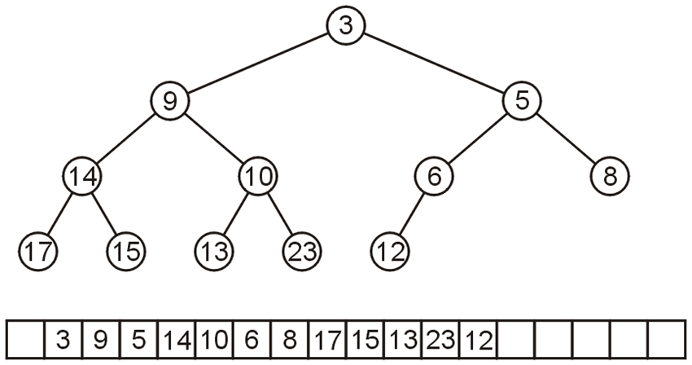
Array Storage (3)
The children of the node with index k are in 2k and 2k + 1
The parent of node with index k is in k ÷ 2
0 1 2 3 4 5 6 7 8 9 10 11 12 13 14 15 16 17

Slide 9
Array Storage Example (3)
Node 10 has index 5
Its children 13 and 23 have indices 10 and 11, respectively
0 1 2 3 4 5 6 7 8 9 10 11 12 13 14 15 16 17

Slide 10
Array Storage Example (4)
Node 10 has index 5
Its children 13 and 23 have indices 10 and 11, respectively
Its parent is node 9 with index 5/2 = 2
0 1 2 3 4 5 6 7 8 9 10 11 12 13 14 15 16 17

Slide 11
Array Storage (4)
Why array index is not started from 0
In C++, this simplifies the calculations
parent = k >> 1;
left_child = k << 1;
right_child = left_child | 1;
0 1 2 3 4 5 6 7 8 9 10 11 12 13 14 15 16 17

Slide 12
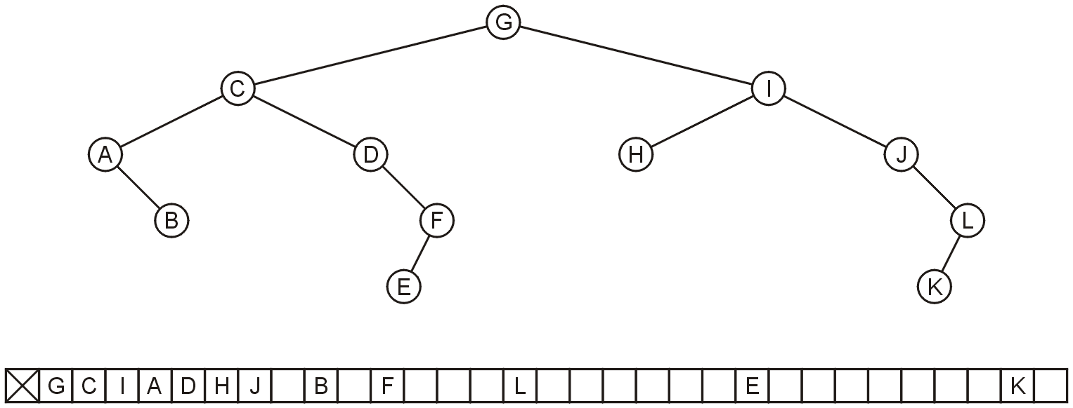
Array Storage: Disadvantage
Why not store any tree as an array using breadth-first traversals?
There is a significant potential for a lot of wasted memory
Consider the following tree with 12 nodes
What is the required size of array?

Slide 13
Array Storage: Disadvantage
Why not store any tree as an array using breadth-first traversals?
There is a significant potential for a lot of wasted memory
Consider the following tree with 12 nodes
What is the required size of array? 32
What will be the array size if a child is added to node K?

Slide 14
Array Storage: Disadvantage
Why not store any tree as an array using breadth-first traversals?
There is a significant potential for a lot of wasted memory
Consider the following tree with 12 nodes
What is the required size of array? 32
What will be the array size if a child is added to node K? double

Slide 15
Linked List Storage

Slide 16
As Linked List Structure (1)
We can implement a binary tree by using a class which:
Stores an element
A left child pointer (pointer to first child)
A right child pointer (pointer to second child)
The root pointer points to the root node
Follow pointers to find every other element in the tree
Leaf nodes have LeftChild and RightChild pointers set to NULL
class Node{
Type value;
Node *LeftChild,*RightChild;
}root;

Slide 17
As Linked List Structure: Example
Root pointer
a
b
c
d
e
f
g
h
i
j
k
l

Slide 18
Tree Traversal

Slide 19
Tree Traversal
To traverse (or walk) the tree is to visit each node in the tree exactly once
Traversal must start at the root node
There is a pointer to the root node of the binary tree
Two types of traversals
Breadth-First Traversal
Depth-First Traversal

Slide 20
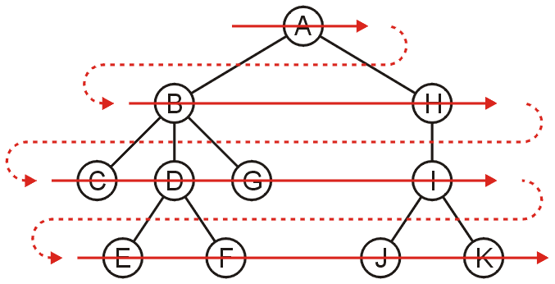
Breadth-First Traversal (For Arbitrary Trees)
All nodes at a given depth d are traversed before nodes at d+1
Can be implemented using a queue
Order: A B H C D G I E F J K

Slide 21
Breadth-First Traversal – Implementation
Create a queue and push the root node onto the queue
While the queue is not empty:
Enqueue all children of the front node onto the queue
Dequeue the front node

Slide 22
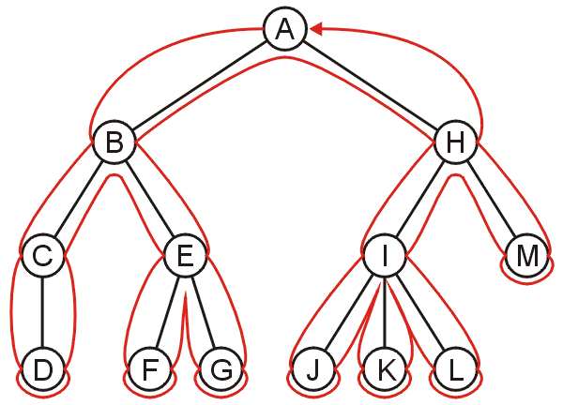
Depth-First Traversal (For Arbitrary Trees)
Traverse as much as possible along the branch of each child before going to the next sibling
Nodes along one branch of the tree are traversed before backtracking
Each node could be visited multiple times in such a scheme
The first time the node is approached (before any children)
The last time it is approached (after all children)

Slide 23
Depth-First Tree Traversal (Binary Trees)
For each node in a binary tree, there are three choices
Visit the node first
Visit one of the subtrees first
Visit both the subtrees first
These choices lead to three commonly used traversals
Inorder traversal: (Left subtree) visit Root (Right subtree)
Preorder traversal: visit Root (Left subtree) (Right subtree)
Postorder traversal: (Left subtree) (Right subtree) visit Root

Slide 24
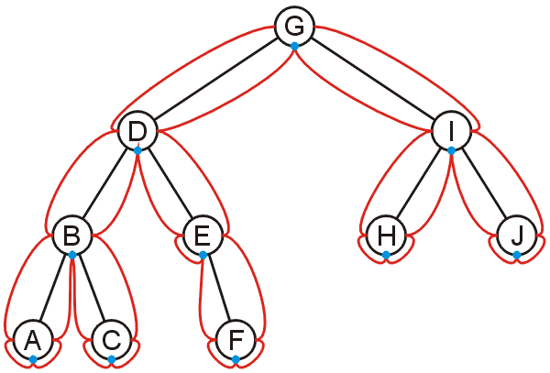
Inorder Traversal
Algorithm
Traverse the left subtree in inorder
Visit the root
Traverse the right subtree in inorder
A, B, C, D, E, F, G, H, I, J

Slide 25
Inorder Traversal
Algorithm
Traverse the left subtree in inorder
Visit the root
Traverse the right subtree in inorder
Example
Left + Right
[Left * Right] + [Left + Right]
(A * B) + [(Left * Right) + E)
(A * B) + [(C * D) + E]
+
*
+
A
B
*
E
C
D

Slide 26
Inorder Traversal – Implementation
void inorder(Node *p) const
{
if (p != NULL)
{
inorder(p->leftChild);
cout << p->info << " ";
inorder(p->rightChild);
}
}
void traverse_inorder () {
. . .
inorder (root);
}

Slide 27
Preorder Traversal
Algorithm
Visit the node
Traverse the left subtree
Traverse the right subtree
Example
+ Left Right
+ [ * Left Right] [+ Left Right]
+ ( * AB) [+ * Left Right E]
+*AB + *C D E
+
*
+
A
B
*
E
C
D

Slide 28
Preorder Traversal – Implementation
void preorder(Node *p) const
{
if (p != NULL)
{
cout << p->info << " ";
preorder(p->leftChild);
preorder(p->rightChild);
}
}
void traverse_preorder () {
. . .
preorder (root);
}

Slide 29
Postorder Traversal
Algorithm
Traverse the left subtree
Traverse the right subtree
Visit the node
Example
Left Right +
[Left Right *] [Left Right+] +
(AB*) [Left Right * E + ]+
(AB*) [C D * E + ]+
AB* C D * E + +
+
*
+
A
B
*
E
C
D

Slide 30
Postorder Traversal – Implementation
void postorder(Node *p) const
{
if (p != NULL)
{
postorder(p->leftChild);
postorder(p->rightChild);
cout << p->info << " ";
}
}
void traverse_postorder () {
. . .
postorder (root);
}

Slide 31
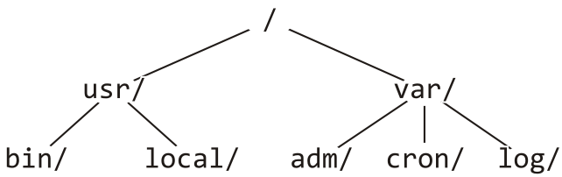
Example: Printing a Directory Hierarchy
Consider the directory structure presented on the left
Which traversal should be used?
/
usr/
bin/
local/
var/
adm/
cron/
log/

Slide 32
Expression Tree

Slide 33
Expression Tree
Each algebraic expression has an inherent tree-like structure
An expression tree is a binary tree in which
The parentheses in the expression do not appear
Tree representation captures the intent of parenthesis
The leaves are the variables or constants in the expression
The non-leaf nodes are the operators in the expression
Binary operator has two non-empty subtrees
Unary operator has one non-empty subtree
+
3
-
*
+
4
5
9
6

Slide 34
Convert Postfix into Expression Tree – Algorithm
1 while(not the end of the expression)
2 {
3 if(the next symbol in the expression is an operand)
4 {
5 create a node for the operand ;
6 push the reference to the created node onto the stack ;
7 }
8 if(the next symbol in the expression is a binary operator)
9 {
10 create a node for the operator ;
11 pop from the stack a reference to an operand ;
12 make the operand the right subtree of the operator node ;
13 pop from the stack a reference to an operand ;
14 make the operand the left subtree of the operator node ;
15 push the reference to the operator node onto the stack ;
16 }
17 }

Slide 35
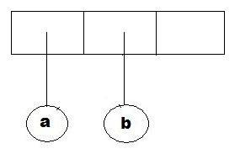
Convert Postfix into Expression Tree – Example (1)
while(not the end of the expression)
{
if(the next symbol is an operand)
{
create a node for the operand ;
push the reference to the created node onto the stack;
}
if(the next symbol is a binary operator)
{
create an operator node;
pop operant from the stack;
make the operand the right subtree ;
pop operand from the stack;
make the operand the left subtree ;
push the operator node onto the stack;
}
}
Example:
a b + c d e + * *

Slide 36
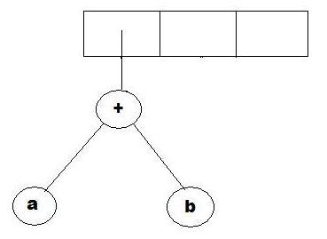
Convert Postfix into Expression Tree – Example (2)
while(not the end of the expression)
{
if(the next symbol is an operand)
{
create a node for the operand ;
push the reference to the created node onto the stack ;
}
if(the next symbol is a binary operator)
{
create an operator node;
pop operant from the stack;
make the operand the right subtree ;
pop operand from the stack;
make the operand the left subtree ;
push the operator node onto the stack;
}
}
Example:
a b + c d e + * *

Slide 37
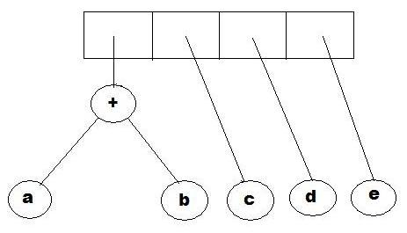
Convert Postfix into Expression Tree – Example (3)
while(not the end of the expression)
{
if(the next symbol is an operand)
{
create a node for the operand ;
push the reference to the created node onto the stack;
}
if(the next symbol is a binary operator)
{
create an operator node;
pop operant from the stack;
make the operand the right subtree ;
pop operand from the stack;
make the operand the left subtree ;
push the operator node onto the stack;
}
}
Example:
a b + c d e + * *

Slide 38
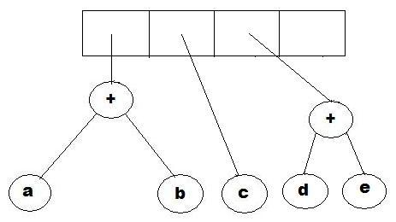
Convert Postfix into Expression Tree – Example (4)
while(not the end of the expression)
{
if(the next symbol is an operand)
{
create a node for the operand ;
push the reference to the created node onto the stack ;
}
if(the next symbol is a binary operator)
{
create an operator node;
pop operant from the stack;
make the operand the right subtree ;
pop operand from the stack;
make the operand the left subtree ;
push the operator node onto the stack;
}
}
Example:
a b + c d e + * *

Slide 39
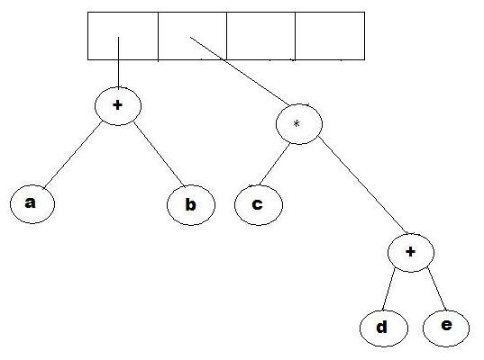
Convert Postfix into Expression Tree – Example (5)
while(not the end of the expression)
{
if(the next symbol is an operand)
{
create a node for the operand ;
push the reference to the created node onto the stack ;
}
if(the next symbol is a binary operator)
{
create an operator node;
pop operant from the stack;
make the operand the right subtree ;
pop operand from the stack;
make the operand the left subtree ;
push the operator node onto the stack;
}
}
Example:
a b + c d e + * *

Slide 40
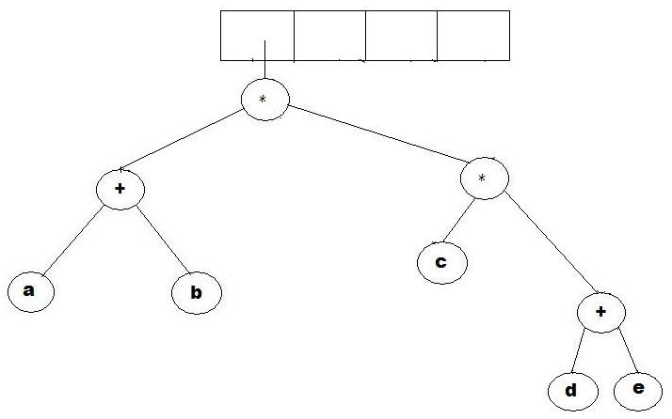
Convert Postfix into Expression Tree – Example (6)
while(not the end of the expression)
{
if(the next symbol is an operand)
{
create a node for the operand ;
push the reference to the created node onto the stack ;
}
if(the next symbol is a binary operator)
{
create an operator node;
pop operant from the stack;
make the operand the right subtree ;
pop operand from the stack;
make the operand the left subtree ;
push the operator node onto the stack;
}
}
Example:
a b + c d e + * *

Slide 41
Why Expression Tree?
Expression trees impose a hierarchy on the operations
Terms deeper in the tree get evaluated first
Establish correct precedence of operations without using parentheses
A compiler will read an expression in a language like C++/Java, and transform it into an expression tree
Expression trees can be very useful for:
Evaluation of the expression
Generating correct compiler code to actually compute the expression's value at execution time

Slide 42
Evaluating an Expression Tree
Perform a post-order traversal of the tree
Ask each node to evaluate itself
An operand node evaluates itself by just returning its value
An operator node has to apply the operator
To the results of evaluations from its left subtree and right subtree
+
Order of evaluation: 3 1 2
(2 + ((5 – 1) * 3))
2
*
-
3
5
1

Slide 43
Evaluating an Expression Tree – Example
Expression: a b + c d e + * *
1 2 + 3 4 5 + * *

Slide 44
Evaluating an Expression Tree - Implementation
1 evaluate(ExpressionTree t){
2 if(t is a leaf)
3 return value of t's operand ;
4 else{
5 operator = t.element ;
6 operand1 = evaluate(t.left) ;
7 operand2 = evaluate(t.right) ;
8 return(applyOperator(operand1, operator, operand2) ;
9 }
10 }

Slide 45
Any Question So Far?

Slide 46
Quiz – Section A
Calculate Preorder, Postorder and Inorder
A
N
D
C
H
L
G
F
E
L
I
J

Slide 47
Quiz – Section B
Calculate preorder, postorder and inorder
A
B
3
C
H
G
K
F
X
L
I
5

Slide 48
Quiz – Section C
Calculate preorder, postorder and inorder
B
Z
C
H
G
K
F
X
L
I
5
O

Slide 49
Array-based Structure (2)
Children of a node at index n is stored at indices 2n and 2n + 1
If array index starts at 1
Unused nodes in tree represented by a predefined bit pattern
[1]
[2]
[3]
[4]
[5]
[6]
[7]
[8]
[9]
…
[16]
A
B
-
C
-
-
-
D
-
…
E
A
B
C
D
E

Slide 50
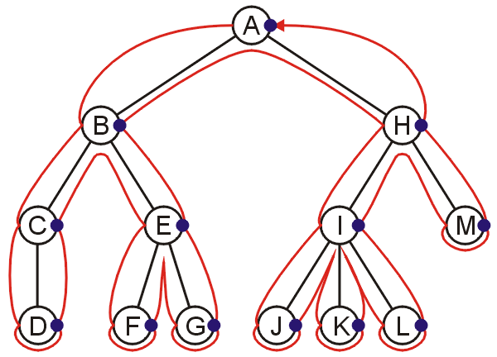
Postorder Traversal
Algorithm
Traverse the left subtree
Traverse the right subtree
Visit the node
D, C, F, G, E, B, J, K, L, I, M, H, A

Slide 51
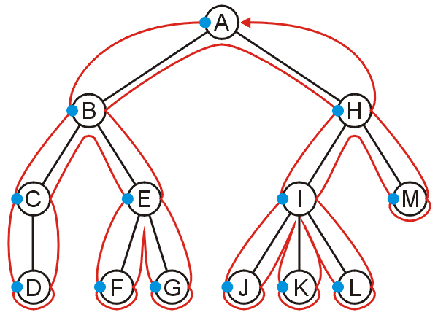
Preorder Traversal
Algorithm
Visit the node
Traverse the left subtree
Traverse the right subtree
A, B, C, D, E, F, G, H, I, J, K, L, M

